Slide 1

Group 4
Imran Esmail, Apurva Godghase, Omkar Kulkarni,
Mrunmayi Modak, Gautami Murugan, Robert Myatt
Notes:
1-7 omkar
8-14 Imran
15-20 Robert
21-25 Gautami
26-33 Mrunmayi
34-43 Apurva
44-45 Gautami
46-49 Robert
http://www.estopwatch.net/countdown.html

Slide 2
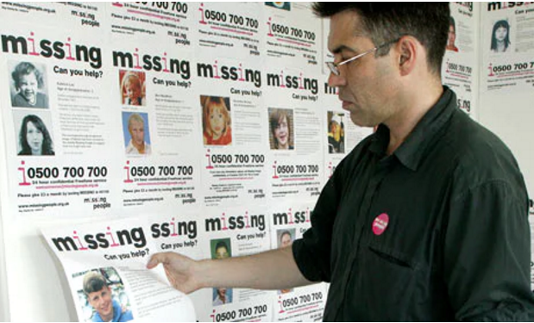
Introduction
According to the National Center for Missing and Exploited Children (citing U.S. Department of Justice reports), nearly 800,000 children are reported missing each year. That's more than 2,000 a day.

Slide 3
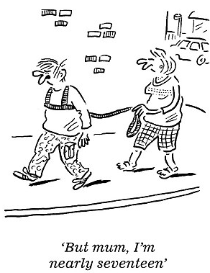
Problem Statement
According to the research conducted by the National Trust Survey:
Children today spend half the time their parents did playing outside. (Four hours a week, compared to 8.2 hours a week)
Almost all (96%) of the 1,001 parents with children aged between 4 and 14 surveyed thought it was important their children should have a connection with nature and thought playing outdoors was important for their development but feared to let them out on their own.

Slide 4
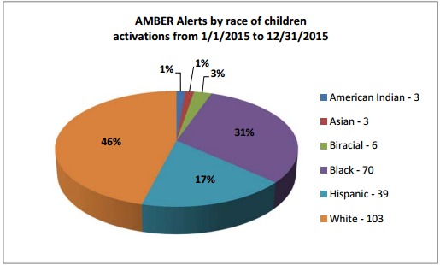
Potential Customers – What do we Know About Them?
Approximately 76.2% of missing children are dead within three hours of the going missing. (The facts about missing children, Amber Alert, 2013)
Notes:
If we analyze our users, we see that according to the amber alert data, white kids constitute the highest percentage of missing children. That means, we can make out primary target the states with high population of white parents . Allocate high % of our of our ad budget into targeting those states first

Slide 5

Why Snowfox ?
SnowFox is a small, portable, tracking device with sensitive built-in location tracking and voice call functionality.
Become a free-range parent: No more caging kids inside the house in front of computer screens.
Easily track your kids with the Snowfox app
Access to historical tracking as well
Easily hide the device in a backpack or inside the jacket so that child abductors cannot easily locate the device.
GeoFence: Get alerts when your child roams out of the specified area that you have set.

Slide 6
A Flavor of Snowfox
https://www.youtube.com/watch?v=8fj5JhfKSN8&feature=youtu.be&t=7m35s

Slide 7


Potential Customers – Who Are They?
THE BUYERS
Parents who are concerned about the safety of their children (Children ages 5 – 10).
Parents with special needs kids (children ages 5 – 15).
For use when families go on vacation or large crowded events
THE USERS
Children between ages 5 – 10.
Special needs children ages 5 – 15.
Secondary market
People whose family members have dementia/Alzheimer's
Notes:
Why? What? Where?
Motivate the parents about the welfare of their children.

Slide 8
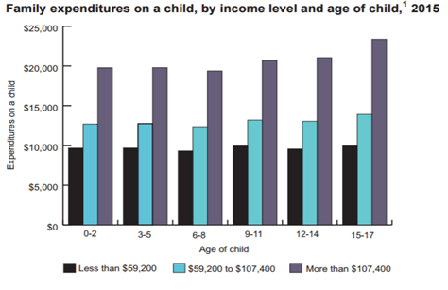
Potential in Terms of Dollars
Statistics are meaningless to parents who worry about their own children.
That's why parents spend considerable portion of their income on their children
Irrespective of the income category parents spend 20% i.e. at least $10,000 of their income on the children. So, there's huge market for SnowFox

Slide 9
Potential Customers – Why Should Parents Buy GPS Trackers? (NEED RECOGNITION)
Peace of mind and sense of relief for parents
For safety concerns such as leaving predefined area
Independence for children as they can go out without direct supervision
In an online poll conducted by Today’s Parents Magazine, 68% of parents said they would track their kids for "safety reasons."
Notes:
(Mrunmayee, Omkar,Apurva wrote) Since, SnowFox is a pseudo communication device, stressing on the point of Abduction is not very beneficial. Consider this situation:
What if the child was kidnapped by someone and his/her mom starts wondering why my child is going in some unknown direction, the first step which she will take is contacting her child. And if kidnapper hears this voice, he will throw the device away. This defeats the purpose.
So if we mainly focus on point of child going missing and not on ABDUCTION, it makes more sense.The tag line of Snowfox is let kids be kids.
Imran Wrote: " I totally agree with you Robert"

Slide 10

Potential Customers – Future Growth
According to ABI research, personal tracking is estimated to grow by 40% each year and is expected to exceed $2 billion by 2021.
Notes:
There is huge potential for personal tracker industry.

Slide 11





Notes:
Trackimo is amazon's best seller. However, it does not have the one way call functionality that snowfox has.
This list is according to my research on the 2017 most popular trackers: http://www.toptenreviews.com/electronics/gps/best-gps-trackers/
Geo Fencing = You can set up a digital fence around a particular zone that you define, such as home or school. The tracker will alert you when it enters or leaves those zones.
Tracking Source= The device gets its signal from GPS and possibly from one or more of the following options: Bluetooth, a short-range wireless connection; Wi-Fi, if the source is open and not password-protected; GSM, short for Global System for Mobiles, the most commonplace and widely-available radio systems that cellular networks like T-Mobile and AT&T use; CDMA, short for Code Division Multiple Access, the system used by Verizon and Sprint, which is generally less available, especially internationally.
We can also add price and battery life as a differentiation point.
Best 10 GPS tracker list
https://wiki.ezvid.com/best-gps-trackers

Slide 12
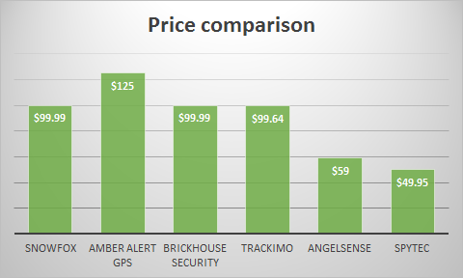
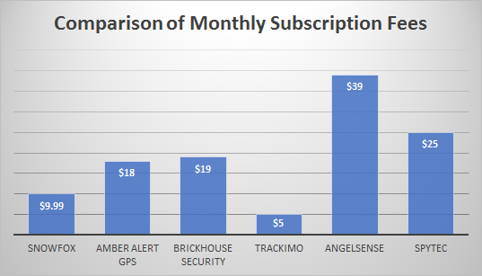
Comparison Of Price and Subscription Fees
AngelSense and SpyTec lowest base price for their devices, their monthly subscription fee is high. This means that a customer will end up paying more in the long run.
With the exception of Amber AletGPS, the device prices for Brickhouse and TrackImo are similar to Snowfox. However, SnowFox has a better monthly subscription plan compared to BrickHouse and Amber Alert GPS.
Notes:
There are other competitors likebrickhouse that offer the same price as snowfox. I find out whatsets snowfox apart from tohers..lets look at the feature comparison..

Slide 13
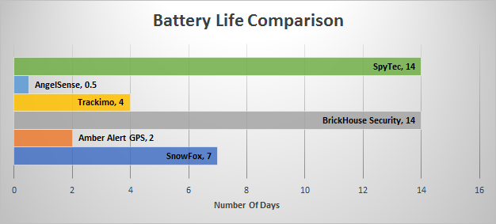
Feature Comparison – Battery Life
SnowFox beats two of the top three (Amber Alert, Trackimo) in terms of battery life.
SpyTec and BrickHouse have twice as much battery life as SnowFox. Their monthly plans also are twice as expensive.
Potential customers have to make a tradeoff between monthly service charge and battery life.
Notes:
Snowfox provides enough bettery life of one week compared toother trackers,with the exception of spytec and brickhouse.Although these two trackers provide longer battery life , their subscription costs are very high. So snowfox is right at the middle, providng you with enough battery life at an affordable price.

Slide 14
Feature Analysis - Detailed Comparison
Device | Waterproof | Calling | Panic Button | GeoFencing Zone | International Coverage | Price
SnowFox | Yes | One - way | Yes | Yes | Yes | $99.99
Amber Alert | Yes | Two - way | Yes | Yes | Yes | $125
BrickHouse | Yes | No | Yes | Yes | No | $99.99
Trackimo | Yes | No | Yes | Yes | Yes | $99.64
AngelSense | Yes | No | Yes | Yes | Yes | $59.00
SpyTec | Yes | No | Yes | Yes | Yes | $49.95
One-way calling allows the parent/guardian to talk to the child anytime. Two way calling allows the child to also call the parent anytime.
Panic Button – When pressed by a child, sends the exact location as a text message to the emergency contacts.
GeoFencing - You can set up a digital fence around a particular zone that you define, such as home or school. The tracker will alert you when it enters or leaves those zones.
Only SnowFox and AmberAlert have calling features. SnowFox can therefore appeal to price sensitive consumers who would like the call feature and all other features at an affordable price.

Slide 15
International Coverage Comparison
Snowfox: United States, Canada, the United Kingdom, Germany, the Netherlands, Spain, Norway, Denmark, Sweden and Finland.
AMBER Alert: 18 EU countries: Belgium, Bulgaria, Cyprus, the Czech Republic, France, Germany, Greece, Ireland, Italy, Luxembourg, Malta, Netherlands, Poland, Portugal, Romania, Slovakia, Spain and the UK.
Trackimo: Worldwide availability 150 countries.
Brickhouse security: Availability confined to United States.
SpyTec: Europe, Asia, Central and South America
Angel Sense: Due to high demand in North America, currently offer service in the USA & Canada only.
Notes:
For this section, we will need to find out exactly what "international coverage" means for Snowfox and the other 5 comptators. Say for example, if snowfox is only offered in North America and Europe, that's not really "international coverage." Will need to list the areas that each device can be used. This will help for positioning when we talk about families going on international trips.
https://en.wikipedia.org/wiki/Child_abduction_alert_system

Slide 16
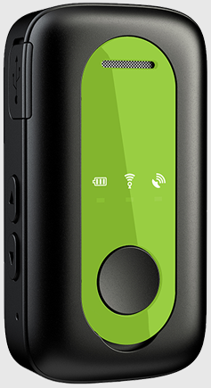
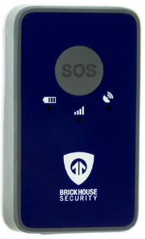
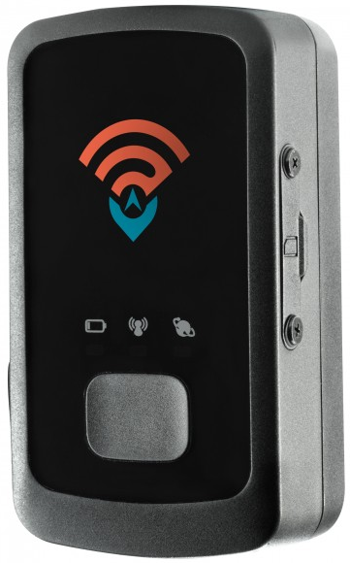
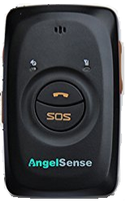
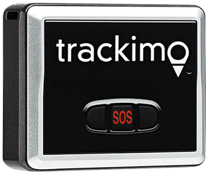
Aesthetic Comparison
Device | Dimensions (LxWxH)
CreditCard | 3.37"x2.13"
Amber Alert | 1.5"x0.8"x2.8"
BrickHouse | 1.57"x0.81"x2.54 "
Trackimo | 1.8"x0.7"x1.6"
AngelSense | 1.9"x0.8"x3"
SpyTec | 2"x0.8"x1"
Amber Alert
Has symbols denoting some kind of communications device
Has volume control
Looks like old phone or remote
BrickHouse
Logos and symbols indicate device purpose
Very prominent well known company logo
Trackimo
Very distinctive name on the device
Very distinctive button
AngelSense
Very distinctive buttons
SpyTec
Logo looks like a wireless communicator on the device
Very distinctive button

Slide 17
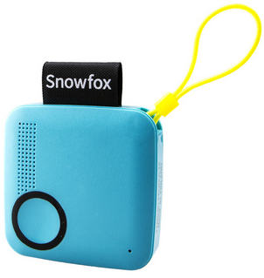
Aesthetic Comparison - Snowfox
Dimensions 1.97"x0.47"x1.97"
Cord
The logo tag is the antenna
Looks like a toy or small ear bud case
Small and inconspicuous

Slide 18
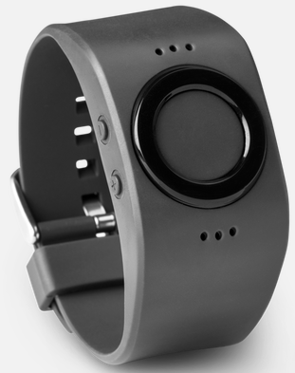

Why Not Other GPS Tracker Categories?
Basic tracking tag
No other features outside of GPS tracking
Tinitell
Looks and acts like a smart watch
Notes:
Explain why use snowfox over say Tinitell. Reason, everybody knows what a smartwatch is. Why not a GPS Tracking tag?

Slide 19
SnowFox Vs. Cell Phone Comparison
Cell phones typically cost several hundred dollars for the phone itself on top of a monthly fee
Break the phone, will cost hundreds again to replace vs the low cost to replace a Snowfox
Even low end phones that have GPS tracking still cost more than most consumer grade GPS trackers
The dimensions of the device is 2"x2" which is much smaller and lighter than a smartphone
Less known from instant glance from kidnapper
The battery of Snowfox tracker phone lasts a week compared to the smartphones battery which last for maximum 2 days

Slide 20
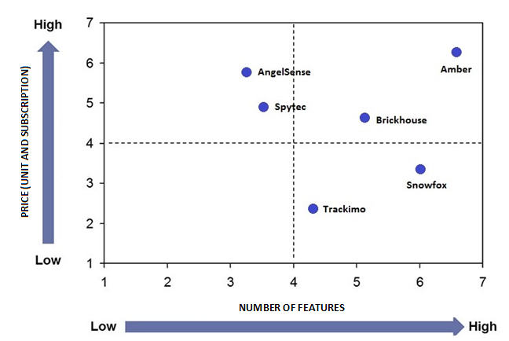
Perceptual Map
Our target market is comprised of different segments with following common characteristics:
Concern for safety of their loved ones
Looking for affordable yet feature rich GPS tracker

Slide 21


Slide 22
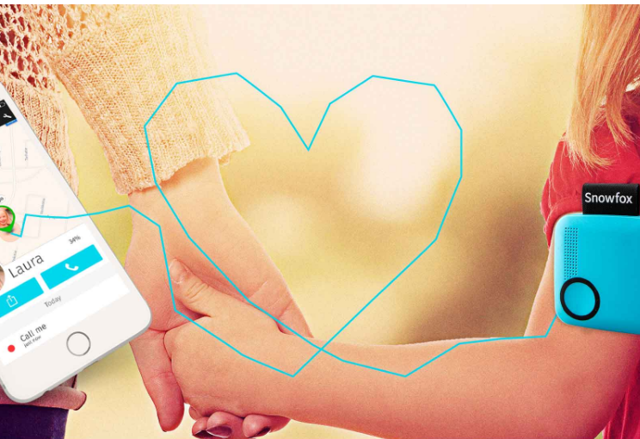
Market Segmentation – Consumer Profiles
Parent/Guardian to child Consumers: With over 875,000 children reported missing in the United States in just the last year, this low-cost device will help families concerned about the whereabouts of their children, by enabling them to keep tabs on their loved ones' locations at any given time.
Notes:
If we are using statistics for children, then we should stick with children only.No need to include elderly, teen, and pets because then it does not make sense.

Slide 23
Market Segmentation – Consumer Profile
Children with special needs
Total children with special needs : 6.3 million In the United States

Slide 24
Geographic
Demographic
The states with the highest number of child population are: California, Texas, Florida, New York, Illinois, Pennsylvania, Ohio, Georgia.
These constitutes almost 50% of the children in the United states.
The Snowfox has potential in the states
Children between the age of 5 to 10 constitute primary users accounting for 16% of the total US population
Notes:
If you look at slide 7, we have specifically segmented children by their race. In doing so, we foind out that white children are abducted more than any other race.
So here,we need to draw another pie chart which shows states with highest white population.Also, we don’t need the demographics pie chart for elders since that is our secondary market.
Need to explainmore about what these are.Titles need to be self-explanatory.

Slide 25
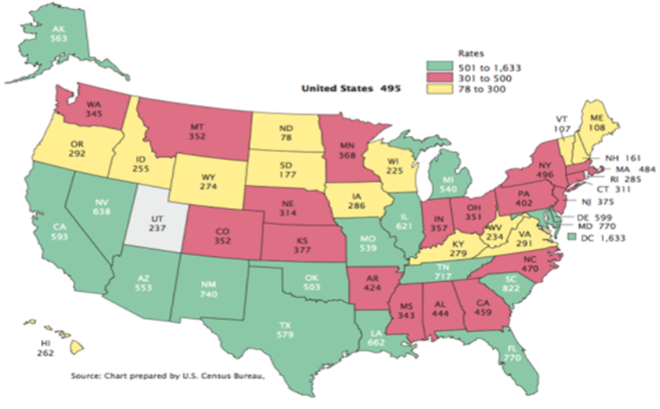
Targeting Customers
The targeting of customers can be done based on the state having the highest number of child kidnappings in the USA.
Notes:
(Abduction again)

Slide 26
Positioning Statement
For parents concerned about the safety of their dependents, SNOWFOX is a personal tracking device that unlike other tracking devices offers more features, is comparatively cheaper, inconspicuous, and is easy to use.

Slide 27
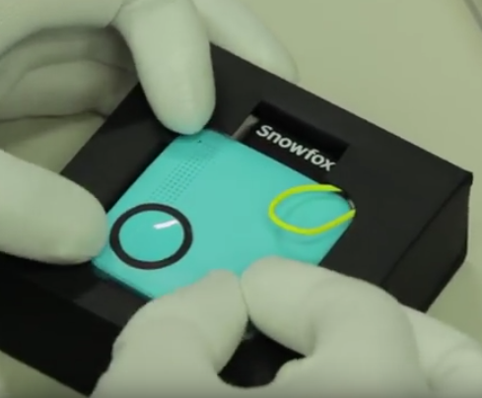
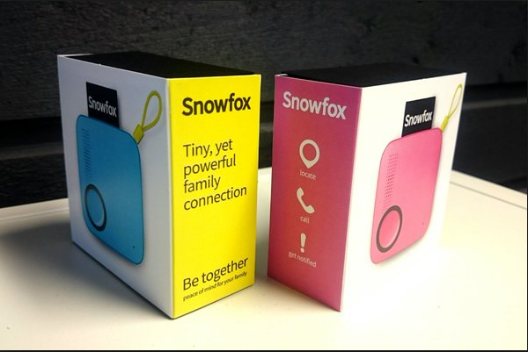
Marketing Plan – Product
Replace yellow loop with plastic clip for better attachability
Ability for custom engraving on Snowfox
Notes:
This slide is supposed to be about what snowfox can do to improve, not what it's doing now.

Slide 28
Marketing Plan – Price
Reward Referrals
Refer SnowFox to someone you know and get your one month fee waived once they sign up.
Bundle payment – 12 Month Discount Payment
Pay as low as $79 on your device and only $7.99 per month for a total of $174 only.
Family Discount Plan
Get extra 5% off with each additional family member in your plan up to 5 devices.

Slide 29
Marketing Plan – Mediums
Online/Social media
Adwords
Have ads on popular parenting sites
Daycare/Schools
Standees at the front of the daycare or school where parents will drop their children off
Pamphlets that get sent out to parents
Parenting magazines
Rent out a page in some popular parenting magazines
Pediatrician/Child Dental Offices
Aforementioned parenting magazines in waiting rooms
Standees at the front desk or waiting room

Slide 30
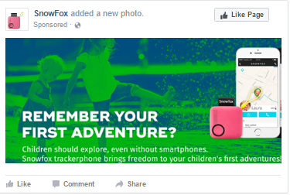
Facebook Ads
To get more people to see and engage with the post or Page.
To reach people more likely to pay attention to the ads and increase awareness for the brand by specifying the target audience.

Slide 31
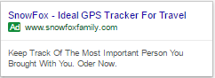
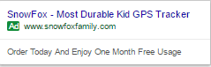
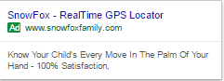
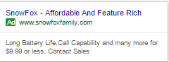
Marketing Plan – Organic Search
Targeted Keywords: Feature Rich GPS Tracker For Kids, Affordable GPS Tracker For Kids, Durable Kids GPS Tracker, Long Battery Life GPS Tracker, etc.

Slide 32

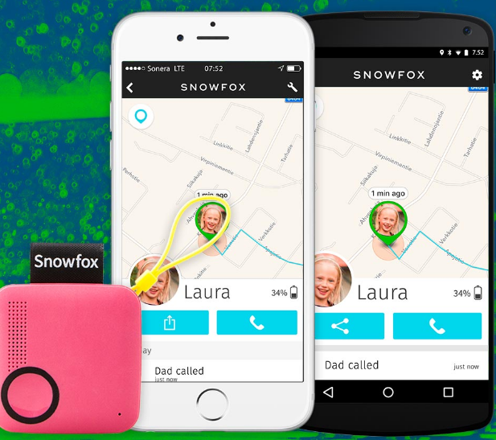
Sample ad
Children should be allowed to explore without boundaries
Snowfox-Your Child's first phone
Notes:
Buy the keywords on google advertising.

Slide 33

Message – Special Needs Children
With Snowfox, you can let your special guy explore with peace of mind
Snowfox-Your Child's First Phone

Slide 34
Promotion – Blog Marketing
There are many blogs that review and rank portable trackers for kids.
Strategy:
Approach a handful of bloggers with a customer base relevant to your product or related products and ask for review
Giveaway free t-shirt, pens, etc as a token of appreciation
Place ads on relevant blogs in the form of banners, links, or videos and negotiate the price with blogger or feature their blog article on your site to help them increase their followers.
Benefits:
A cost effective way to reach and inform the right audience about the product and its features.
Content syndication: The blog might be referred to by other blogs. Eg. A blog about cheap trackers might reference content about Snowfox.
Valuable customer reviews at no cost: Comments posted by the users on the blog will be used to improve the product.

Slide 35
Distribution
Daycare/Schools
Have flyers distributed to children/parents that they can purchase Snowfox and it be delivered to their home or to the school
Pediatrician/Child Dental Offices
Have small standees with information about Snowfox with a QR code that allows a smartphone to automatically go to the website
Infomercials on TV
Have Snowfox be sold through QVC

Slide 36

India: A Potential Market
Why India?
Population: 1.2 Billion
Vast diversity and large number of religious gathering
For e.g. In 2013, around 30 million people gathered for Kumbh Mela pilgrimage. Almost 300,000 children were reported missing during this 55 day festival.
On an average, 180 children go missing every day in India which's 1 child every 8 minute

Slide 37
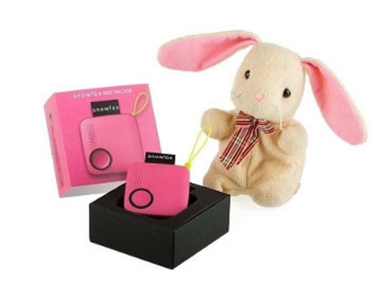
Renaming the Product: Why PlayTag?
It is a tag like wearable tracking device while the kids can play and roam around freely
Reassurance for parents
Safety and Independence for kids

Slide 38
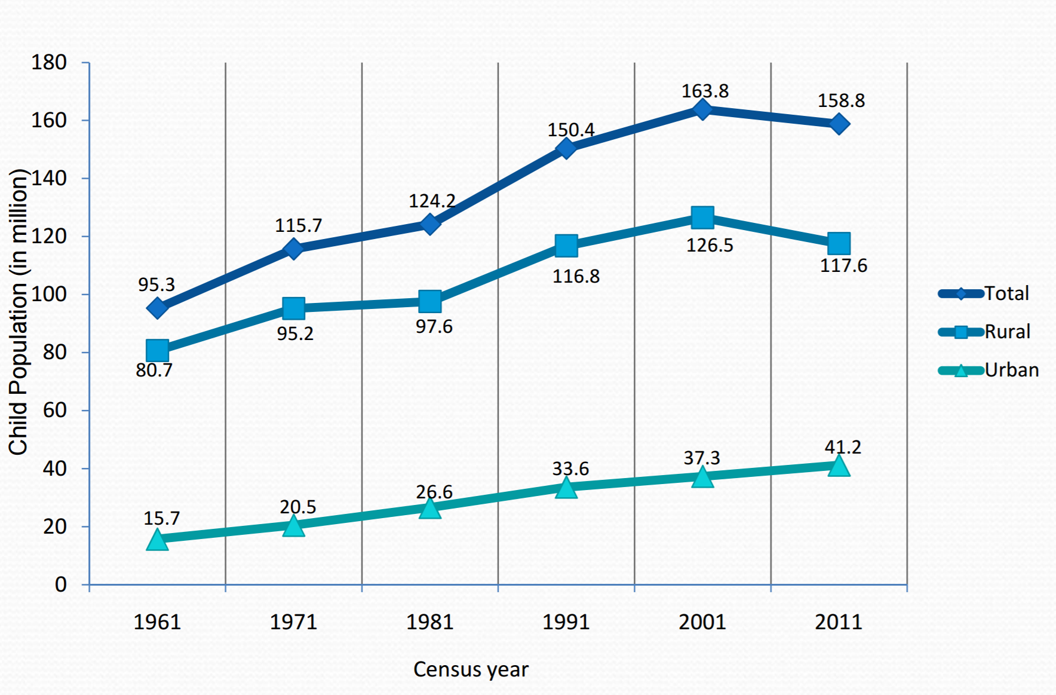
Target Customers in Indian Market- Analyzing Customer Behavior
According to survey conducted by a leading newspaper in India:
Due to the IT boom in India, parents are spending less time with their kids but have more money to spend on them.
Children are going to daycare/playschool at an increasingly early age.
Parents have become more obsessive about their children and at the same time have also become more hands-off, delegating key tasks to maids, grand-parents, tutors, schools and other institutions and demanding greater accountability from them.
There is rising concern among these parents about the safety and knowing the whereabouts of there children and willing to invest in tracking systems.
From the Census data, out of the 158.8 million children, there are 41.2 million children in the urban areas.

Slide 39
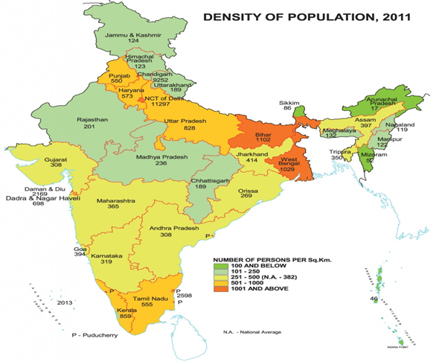
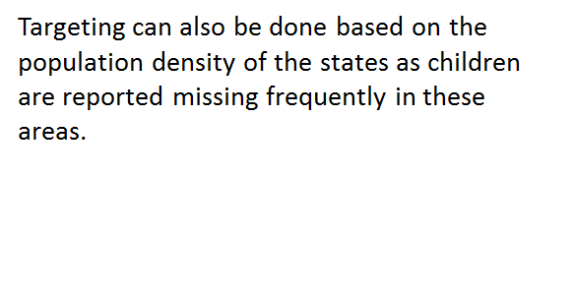
Targeting in India
Notes:
Lets keep this for report and we can tell this single fact while presenting

Slide 40
Targeting In India
Top five states where there is a major difference in missing and recovered children.
The total number of untraced children in 2015 was 62,988 as against 34,444 in the year 2013 which is 84% rise
Notes:
(Talking point: "West Bengal, Uttar Pradesh and Delhi population density is high")
This is repetition and"On an average, 180 children go missing every day in India" slide 37

Slide 41
Positioning Statement for India (PlayTag)
For working professionals, concerned with the whereabouts of their children, PlayTag is a GPS tracking wearable device with calling functionality and is first of its kind in the Indian market

Slide 42
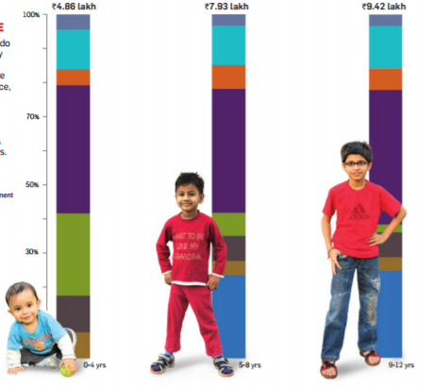
Pricing
In India, due to the vast population, the problem of children going missing is more severe
Parents having the capacity to afford this type of product is not uniform
It is not feasible to sell the product at the same price in United States or Europe so we plan to introduce a low cost product with slight different features

Slide 43
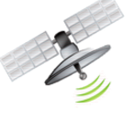

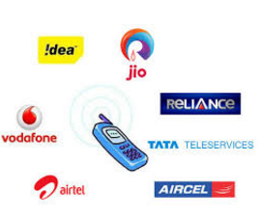



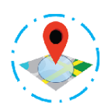

Change in Product Features
International Coverage Restriction
Wearable Device
Low Cost Carrier
Reduced battery life
App And Reports Retained
S.O.S
GeoFence
Calling feature Retained

Slide 44
Distribution in India
Daycares / Schools
Public Parks
Cafeterias of IT companies
Advertisements on local trains and bus stations – majority of the working population in the cities uses these for daily commute to work

Slide 45
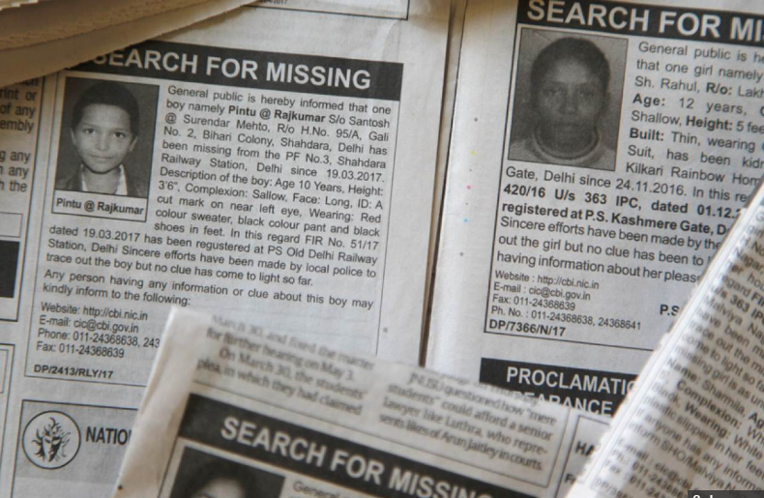
Why PlayTag in India
Security is less
Cameras – malls, public places, etc
Police reporting – procedure is long – take time for action
Number of missing cases reported/day :180
Instant facility – 911 n/a
Over-protective nature, long – period with parents
Parents spend most of their savings on Children.

Slide 46
Cost Analysis – Financial Forecast American Market
Cost Per Tracker | $47
Initial Investment Cost ( For First Year) | $100,000
Yearly Margin Per Tracker | Subscription profit + tracker profit => ($9.99 * 12) + ($99 -$47) = $171.88
Units Sold To Breakeven | FC/ (Margin) = $100,000/ 171.88= 582 units.
Units Needed To Breakeven | 582
Target Units To Sell Per Month | 200
Total Estimated Months To Breakeven | Approximately 3 months
Estimated Units Sold Per Year | 2400
Total Estimated Profit Margin Per Year | 2400 * 171.88= $412,512

Slide 47
Cost Analysis – Financial Forecast Indian Market
Cost Per Tracker | INR 3000
Initial Investment Cost (One Year) (Includes cost for Advertising, Taxes, Certification etc...) | INR 6,480,000
Yearly Margin Per Tracker | Subscription profit + tracker profit => (INR. 149* 12) + (INR. 3000) = INR 3,588
Units Sold To Breakeven | FC/ (Margin) = 64,80,000/3588=1806.01
Units Needed To Breakeven | 1806
Target Units To Sell Per Month | 450
Total Estimated Months To Breakeven | 4.01 months
Estimated Units Sold Per Year | 5400
Total Estimated Profit Margin Per Year | 5400*1200=8640000
Notes:
GPS tracking phone is India cost

Slide 48
Limitations to Success
Product isn't unique, is easily copy able, and isn't hard for somebody to create a new company selling these.
Resolution: Building the brand
With entering the Indian market, we have the advantage to build the brand.
Product isn't well received
Children refuse to use the device.
Advertising mediums don't want to allow the advertisements.

Slide 49

Questions?

Slide 50
S
W
Real time GPS location
Voice call functionality
Up to 1 week of battery life(single charge)
Powerful antenna
Durable and play proof
Free app
Weatherproof/Waterproof
Geo fencing
call me notification through companion app
Tiny and easy to carry
STRENGTHS
WEAKNESS
Limitation-Coverage area
Limited Carrier support
Dependence on third party provider
INTERNAL FAKTORS
O
T
OPPURTUNITIES
THREAT
Worldwide availability
Two way calling
High densely populated areas
Bigger companies can copy idea
Existing Competitor products
New market entrants
ETERNAL FAKTORS
POSITIVES
NEGATIVES
Notes:
THIS SLIDE IS ONLY FOR REFERENCE

